Slide 1
Islamic Arguments Against
Militantant Jihadist Terrorism
(Imam Dr)
Usama Hasan
Senior Analyst
Extremism Policy Unit
Presentation to ICSVE, 22 March 2022

Slide 2
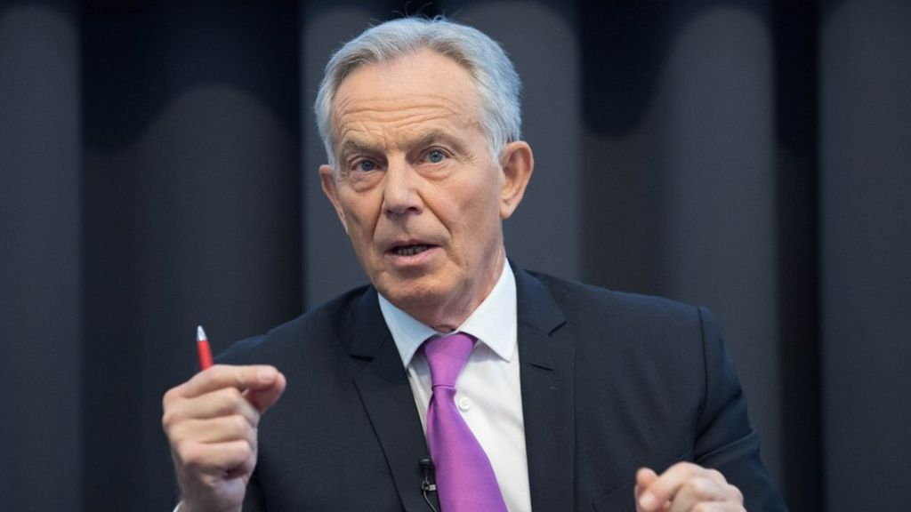
Sir Tony Blair, January 2019
(We must distinguish between Islam & Islamism: they are not the same.)
“Of the billions spent since 9/11 on countering Islamist extremism & terrorism, very little has been invested in tackling the underlying ideology.”

Slide 3
SYNOPSIS
Radicalisation & Deradicalisation:
my journeys into & out of Salafism & Islamism
into post-Islamism & post-Salafism
Thesis: the 4 pillars of Islamism
Antithesis: critiquing the 4 pillars of Islamism
Synthesis: the 4 pillars of post-Islamism

Slide 4
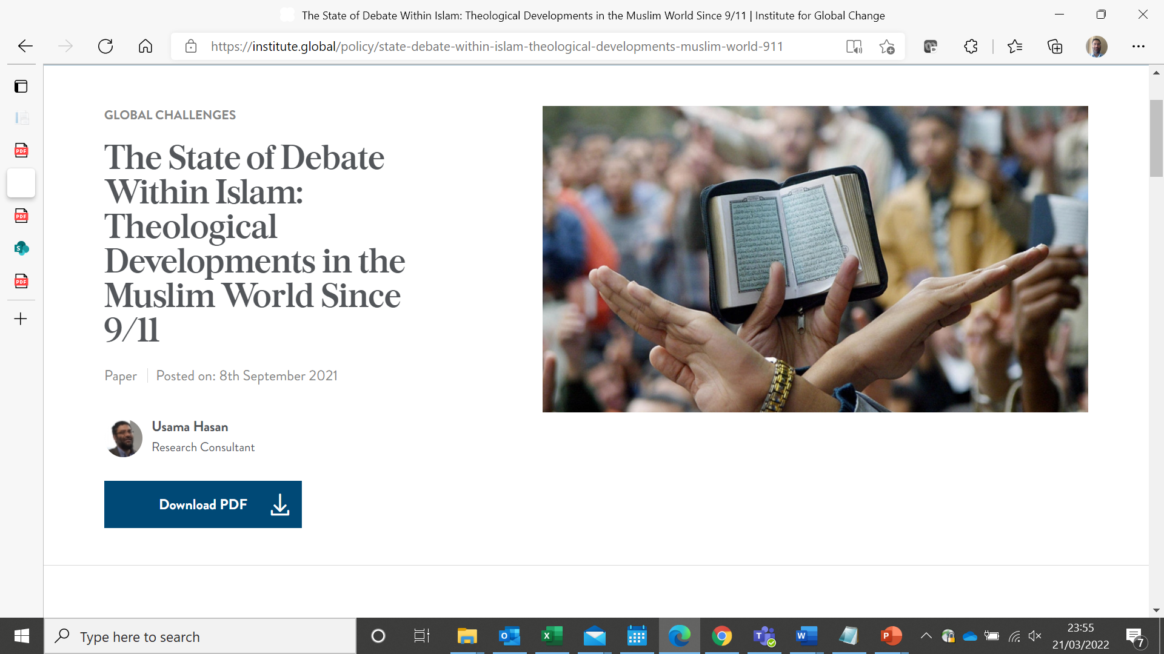

Slide 5
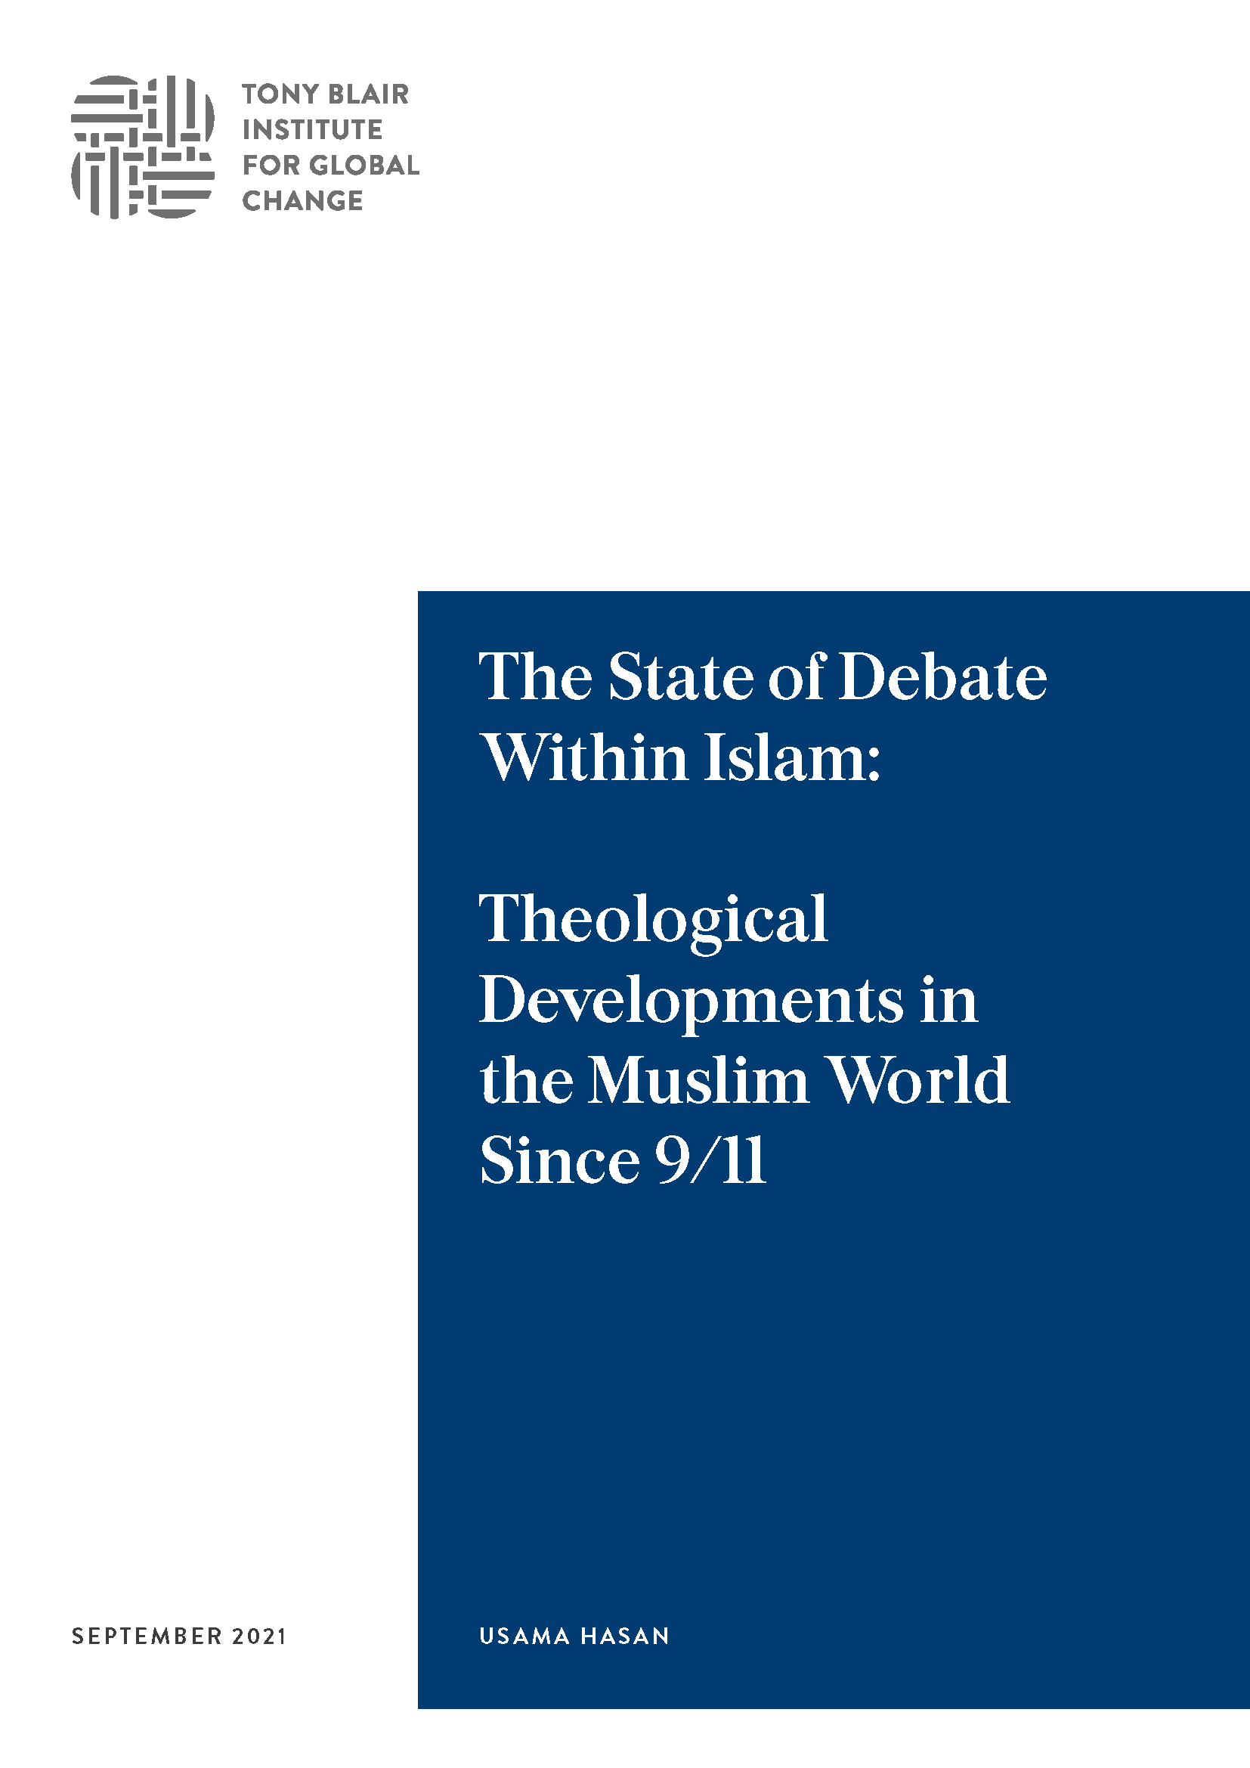

Slide 6
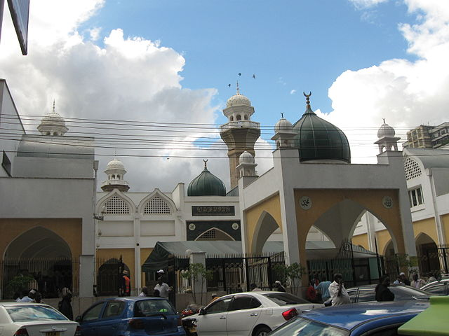
NAIROBI (KENYA), 1971-6
Source: Ruslik0, Creative Commons

Slide 7

Primary School, North London, UK (1976-83)

Slide 8
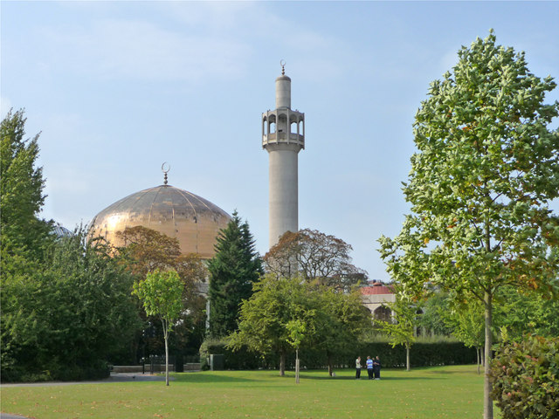
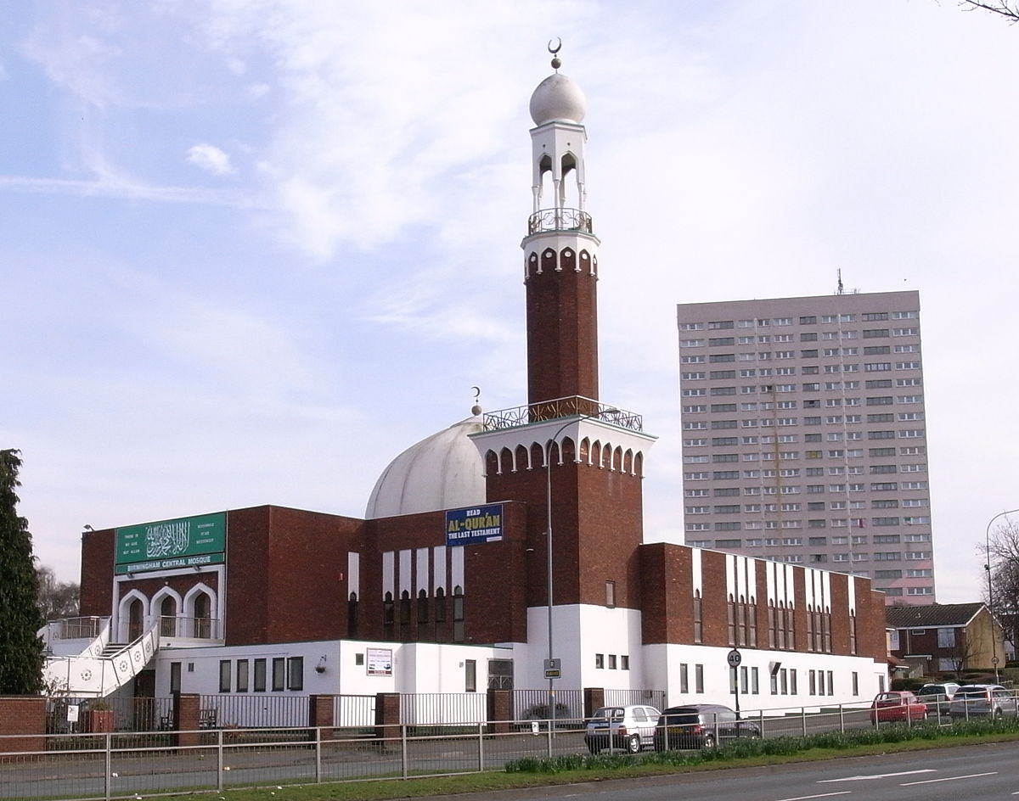

Growing up with racism in the UK, 1970s-1990s

Slide 9
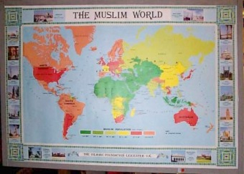
IDENTIFICATION WITH MUSLIM WORLD POLITICS

Slide 10
IDENTIFICATION WITH MUSLIM WORLD POLITICS
1979: Iran Revolution; Siege of Mecca; USSR invades Afghanistan
1980s: Afghan Jihad v USSR, Iran-Iraq war
1981: Assassination of Sadat of Egypt for peacemaking with Israel
1982-97: Israeli occupation of South Lebanon; rise of Hizbullah
1987-2005: 1st & 2nd Palestinian Intifadas: rise of Hamas
1990-1: Saddam occupies Kuwait; expelled by US-led coalition
1992-5: Bosnia war; Muslims face genocide: Srebrenica massacre
1992-6: Fall of Kabul; mujahideen civil war; rise of the Taliban
1996-2001: Taliban rule in Afghanistan, leading to 9/11

Slide 11
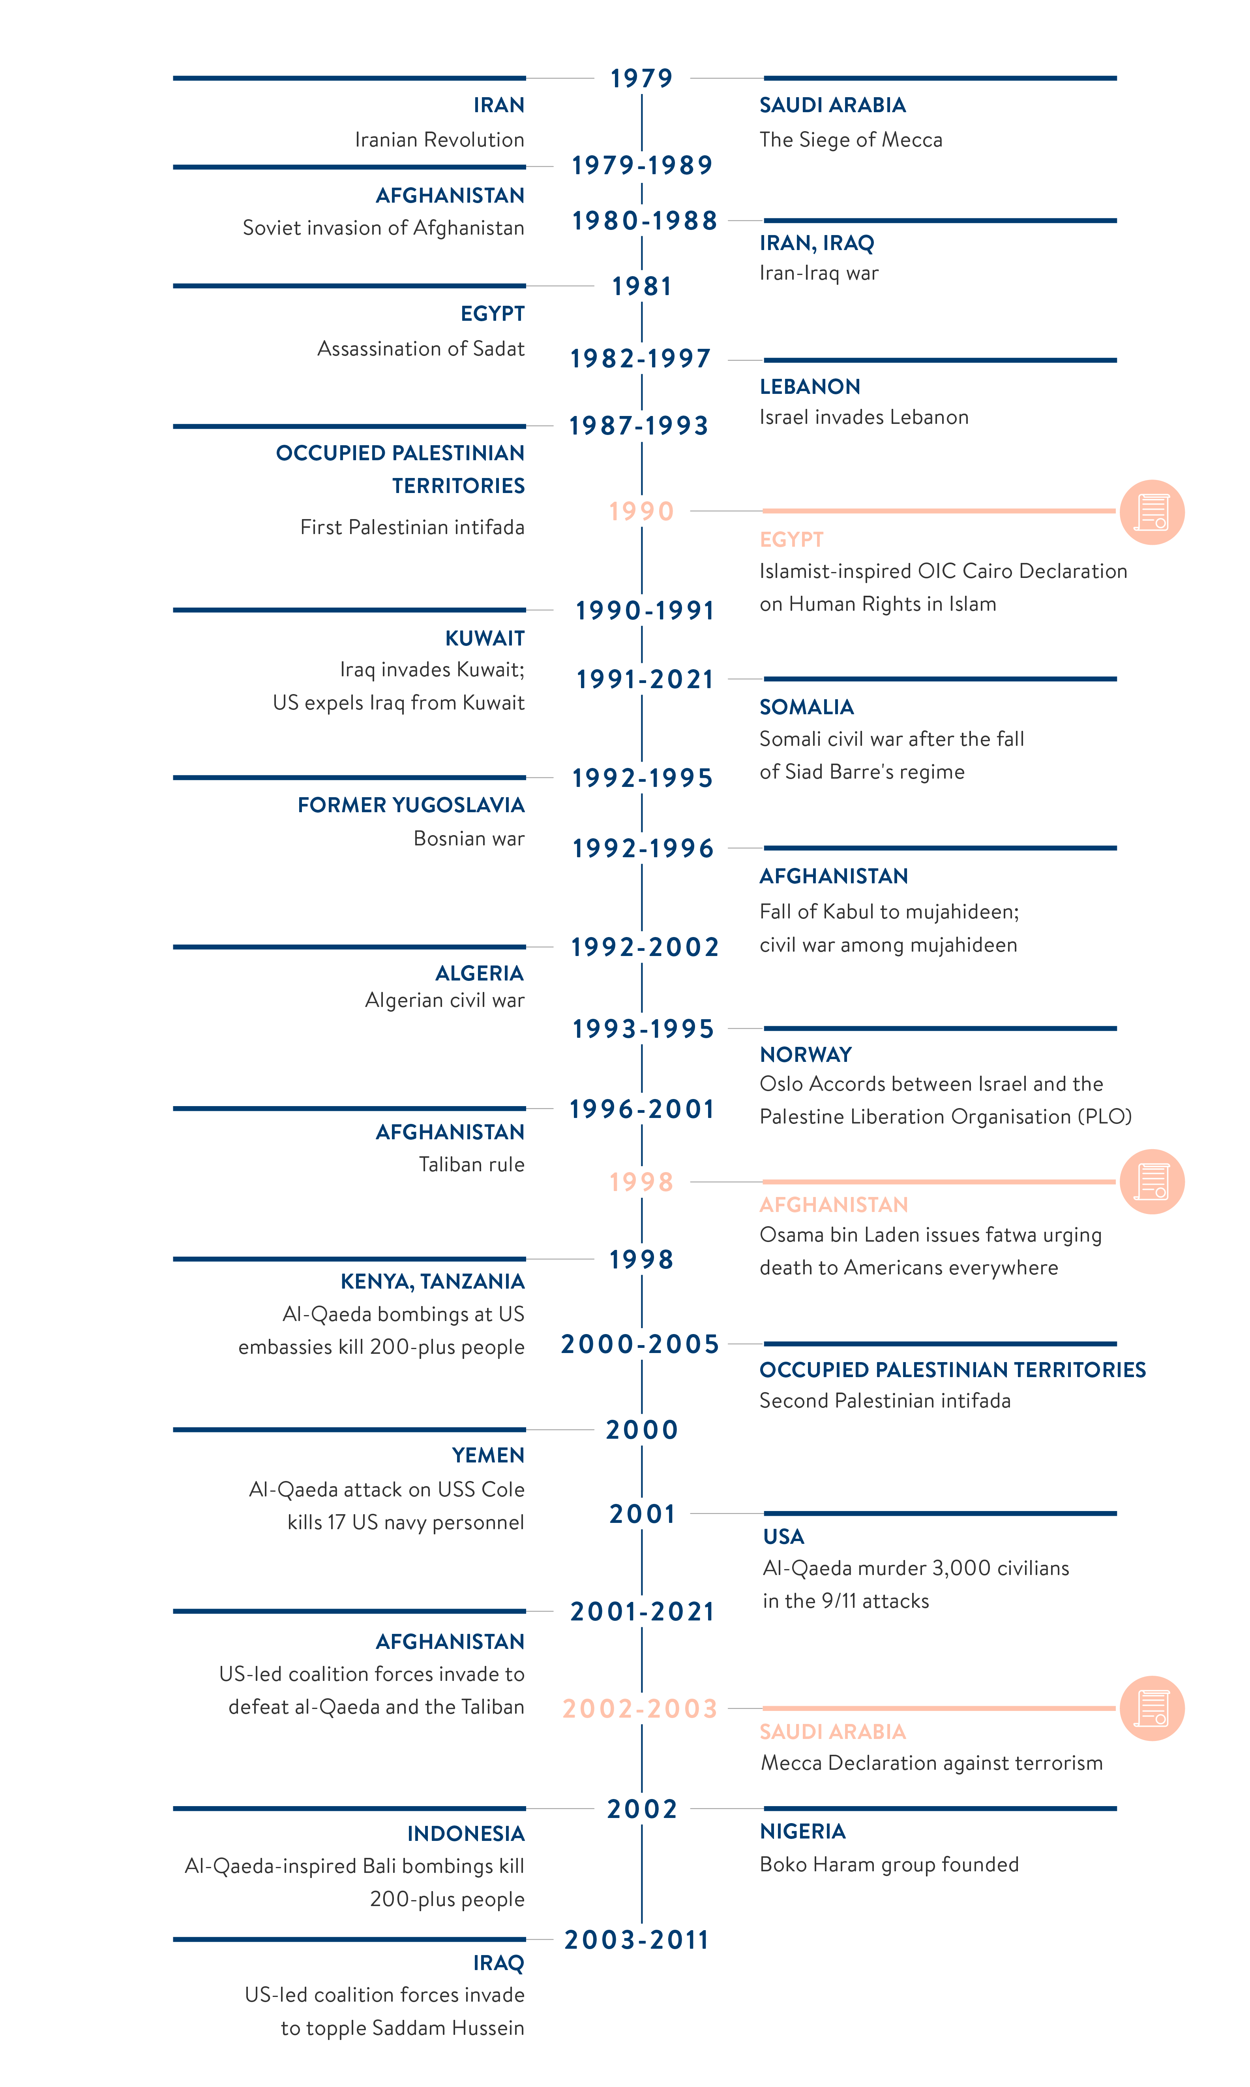
CF. TIMELINE (1979-2021) IN THE STATE OF DEBATE WITHIN ISLAM:
THEOLOGICAL DEVELOPMENTS IN THE MUSLIM WORLD SINCE 9/11

Slide 12
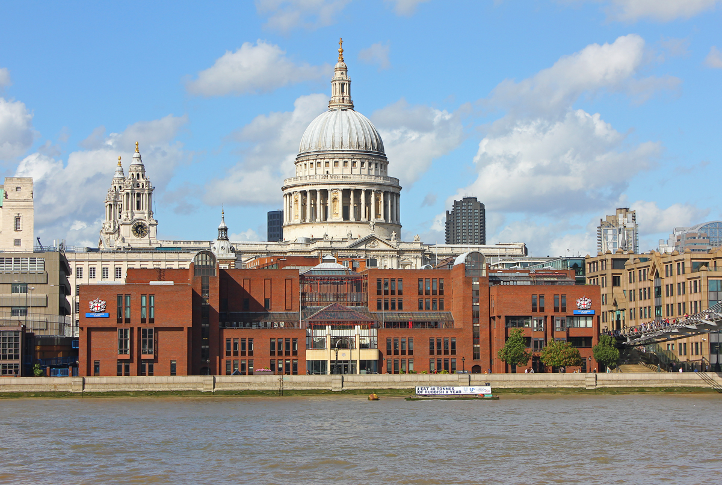
Independent Secondary Schooling, London, 1983-9
John Carpenter Scholar, City of London School, 1987-9

Slide 13
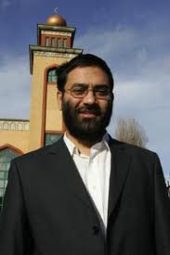
Imam at Al-Tawhid Salafi Mosque, London (1985-2011): partnership with JIMAS, Western world’s largest Salafi group
SALAFI SPECTRUM: QUIETIST --- POLITICAL --- JIHADI (TAKFIRI)
JIMAS & UK Salafis had complex journeys across this spectrum

Slide 14
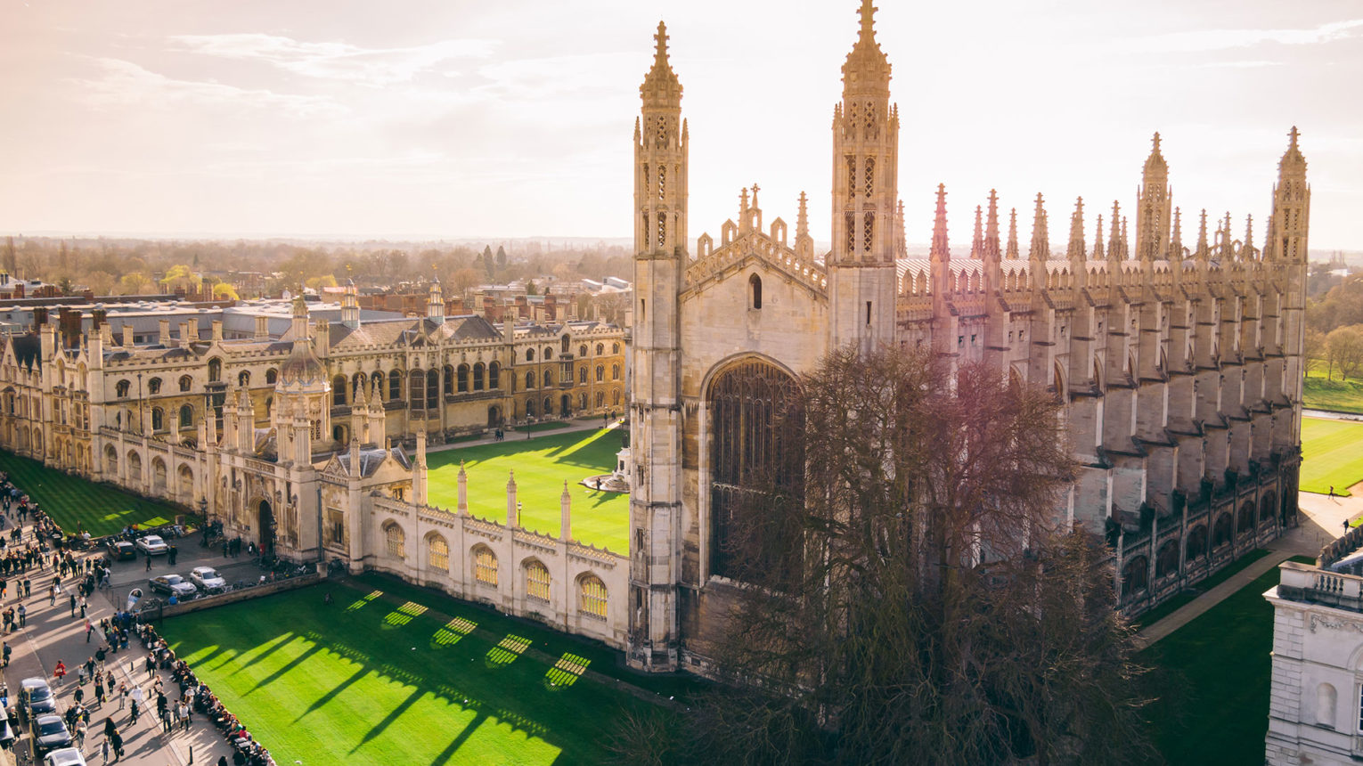
Cambridge University (1989-92):
M.A. (Hons.): Physics & Theoretical Physics

Slide 15
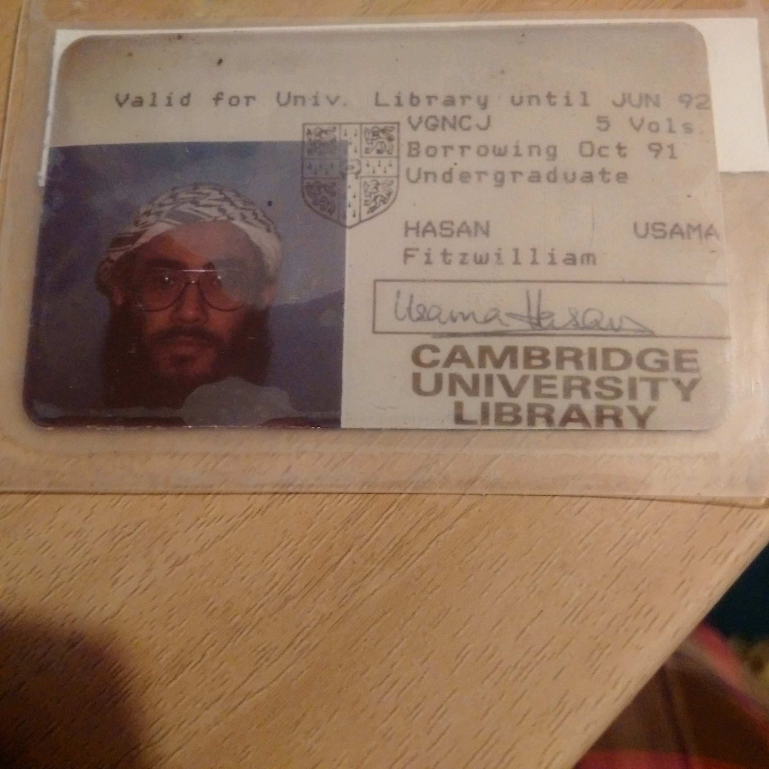
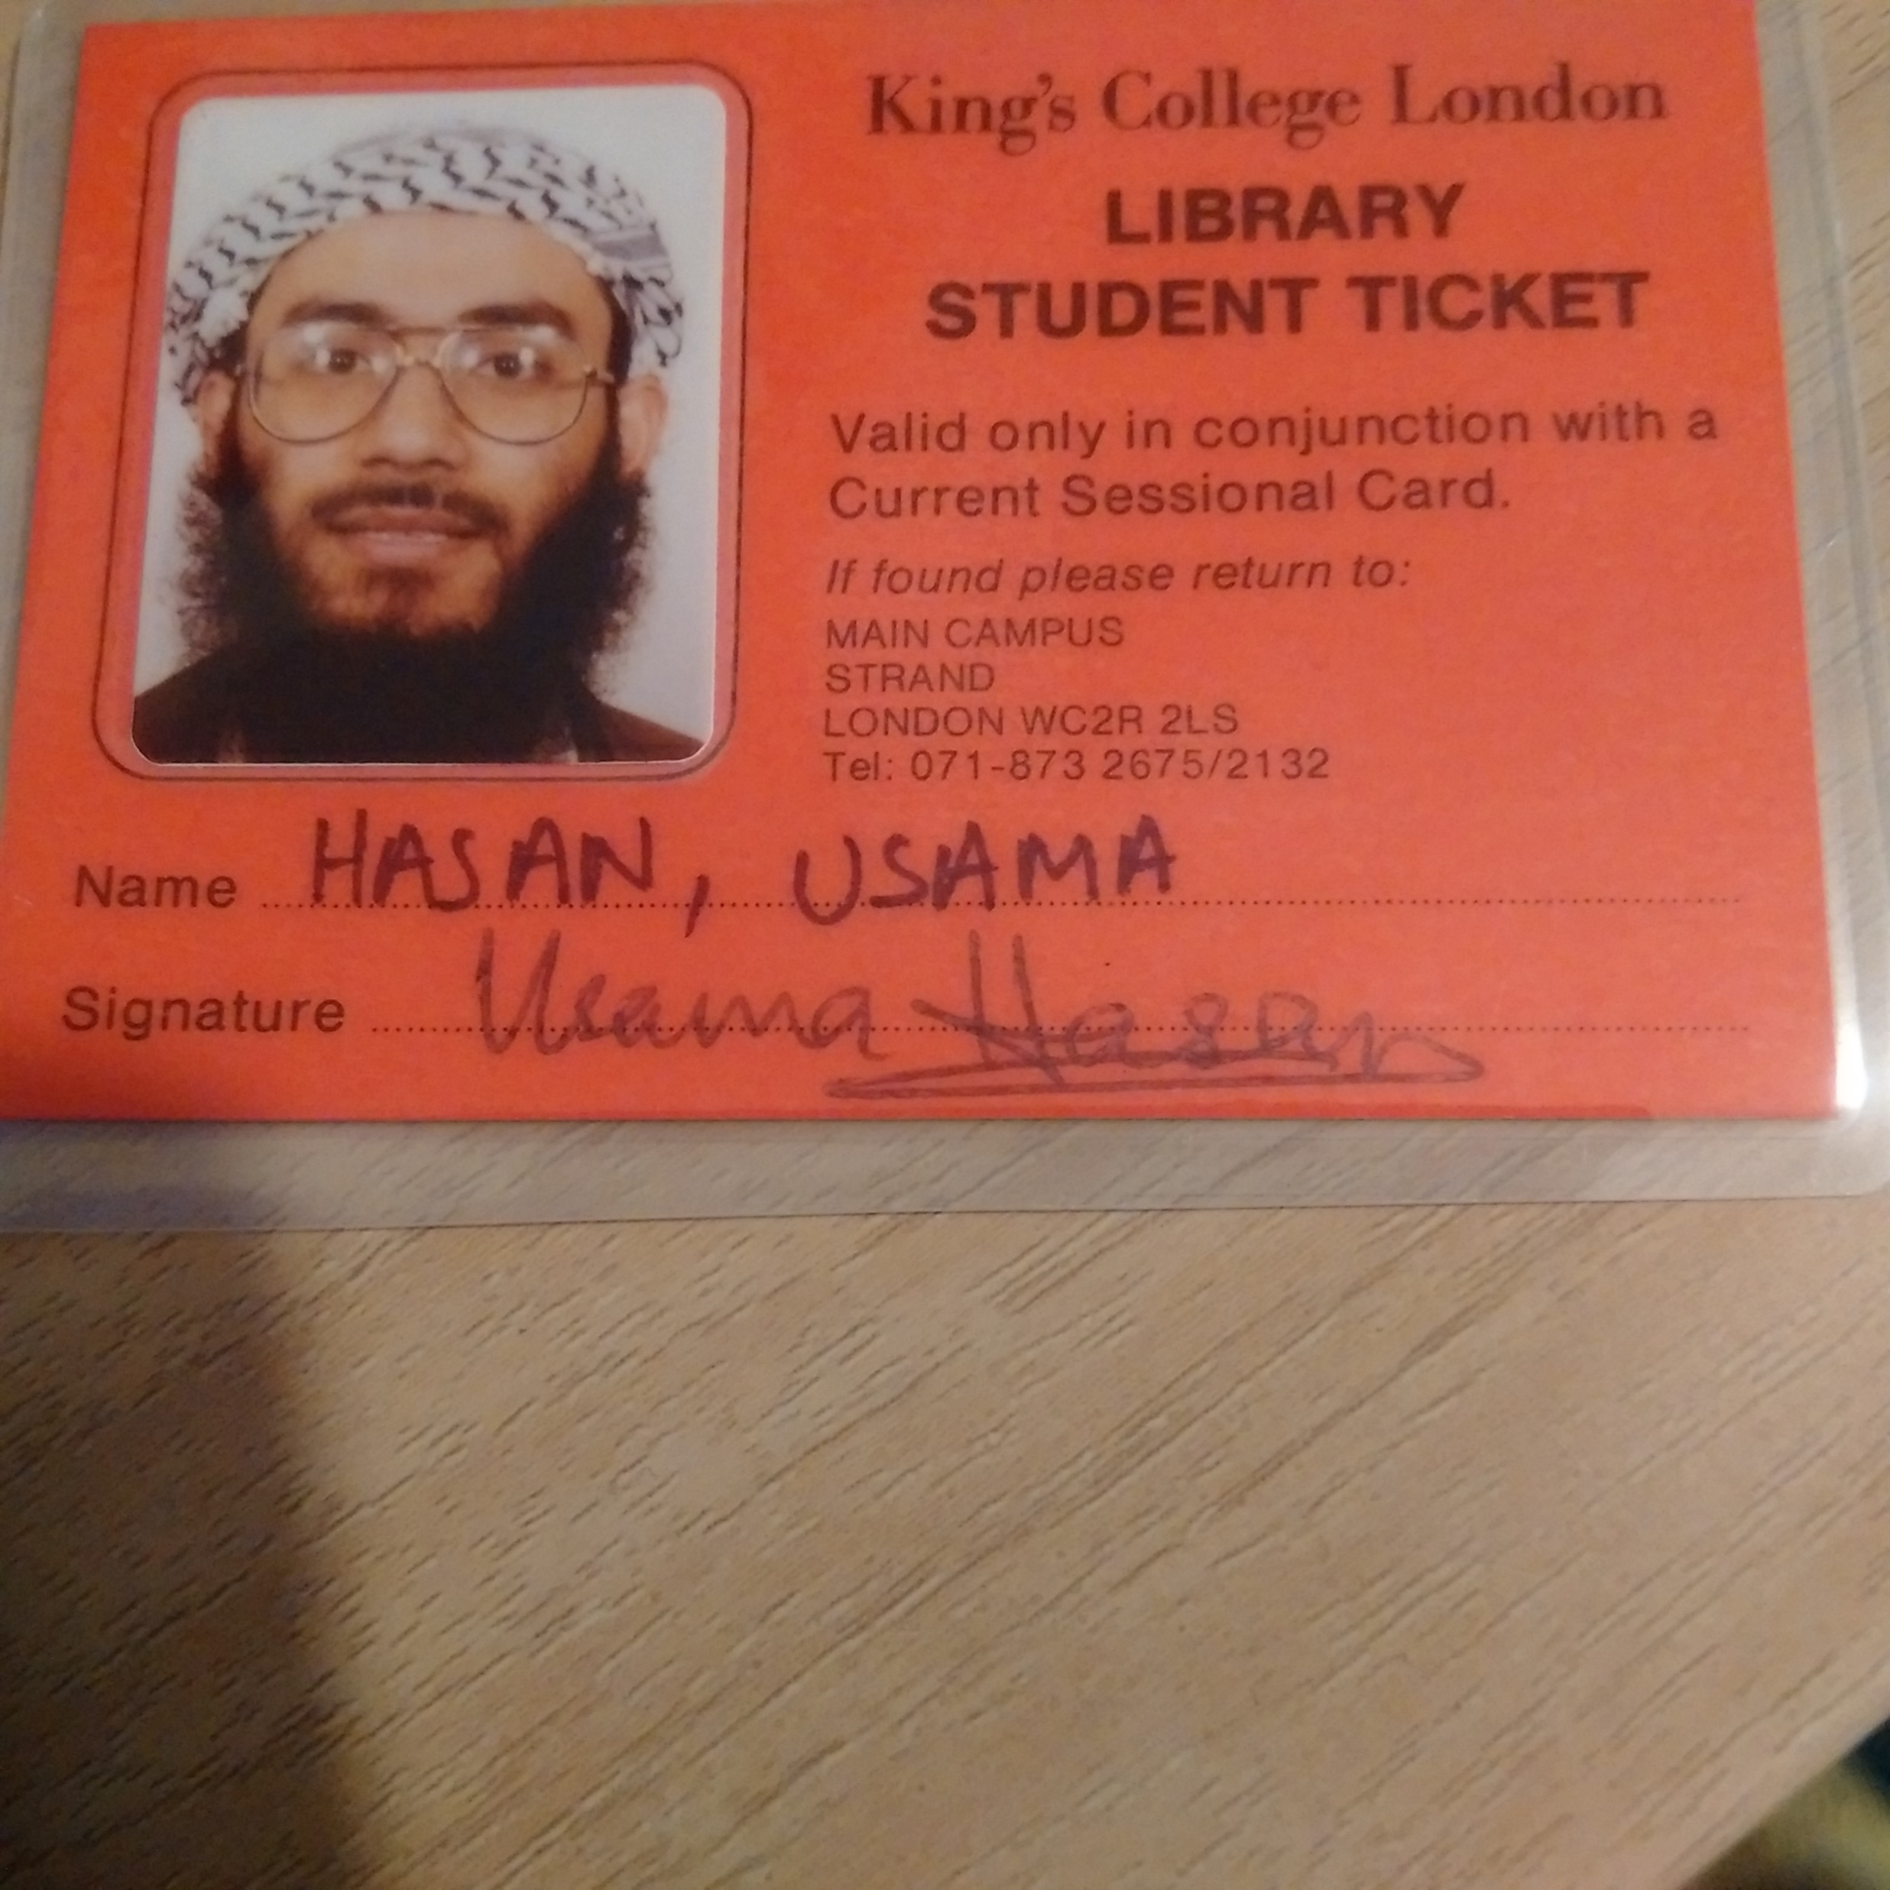
Universities of Cambridge & London: 1989-97
1993: MSc in Artificial Intelligence, University of London
1998: PhD in Artificial Intelligence, University of London

Slide 16
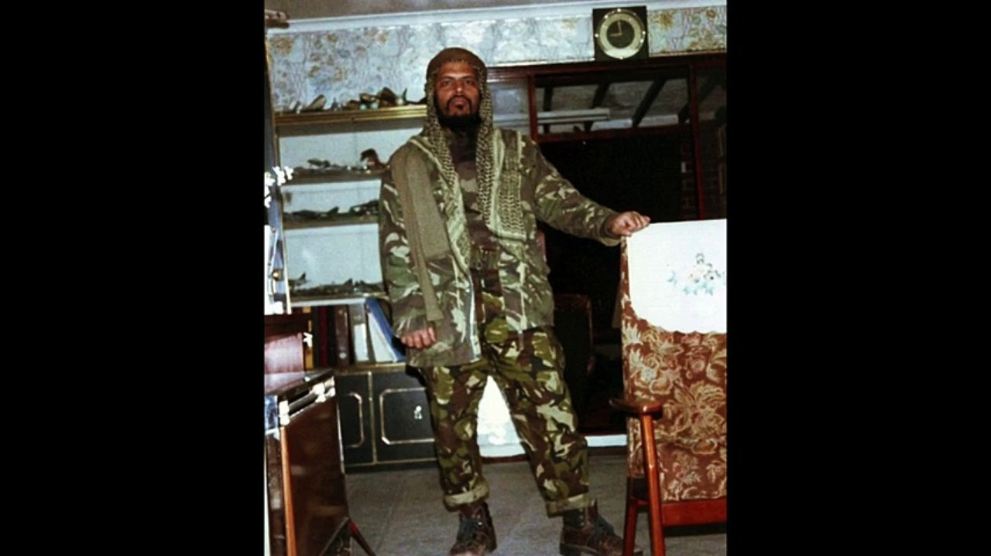
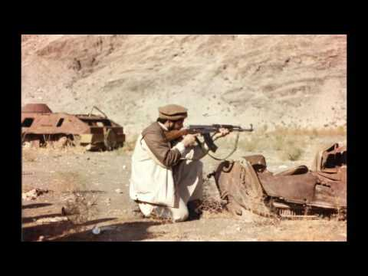
Jihad in Afghanistan (1990-1) with Sheikh Manwar Ali
UK jihadis also fought in: Bosnia, Kashmir, Chechnya, Burma
cf. Manwar Ali,
Inside the Mind of a Former Radical Jihadist, TED talk, 2017

Slide 17
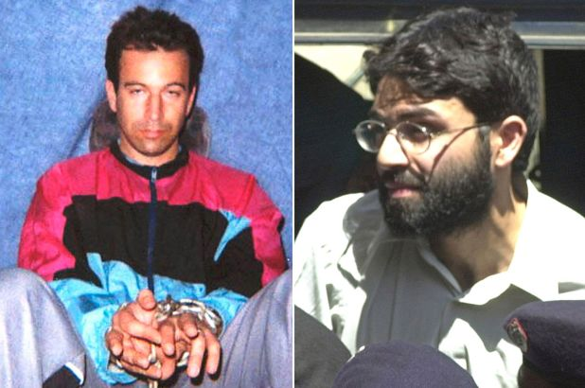
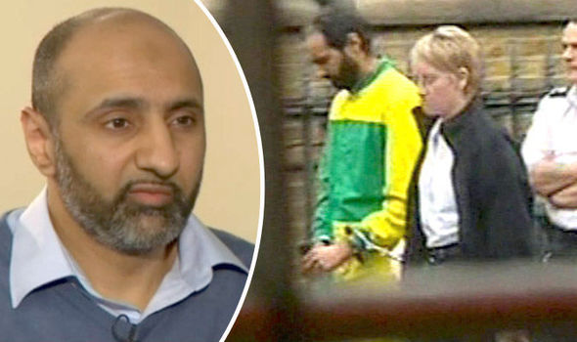
SALAFI / DEOBANDI JIHADIS AT UK UNIVERSITIES
King’s College London / London School of Economics:
Omar Sheikh,
kidnapper of
Daniel Pearl (WSJ)
Imperial College of Science, Technology & Medicine:
Babar Ahmad,
Founder of Azzam.Com

Slide 18
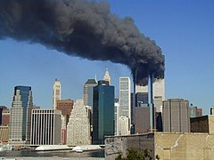
9/11 – NYC, 2001
Source: Flickr user Michael Foran, Creative Commons Attribution 2.0

Slide 19
PAKISTAN, 2002-3
‘War on Terror’ in Afghanistan next door
Met Jihadis who were politically crazy
Missed my British & Western side,
in an Eastern & Muslim context

Slide 20
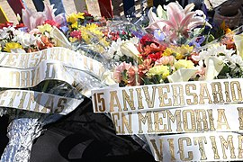
3/11 – Madrid, 2004
Source: Diario de Madrid, Creative Commons Attribution 4.0

Slide 21
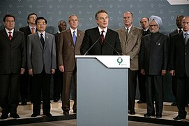
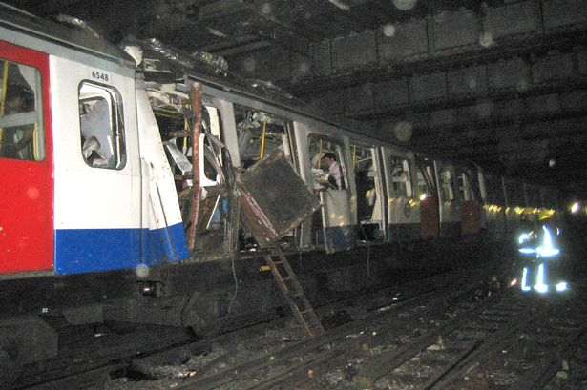
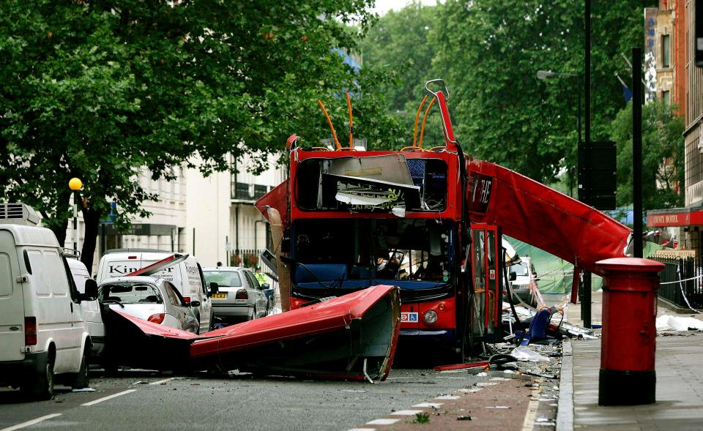
7/7 – London, 2005

Slide 22
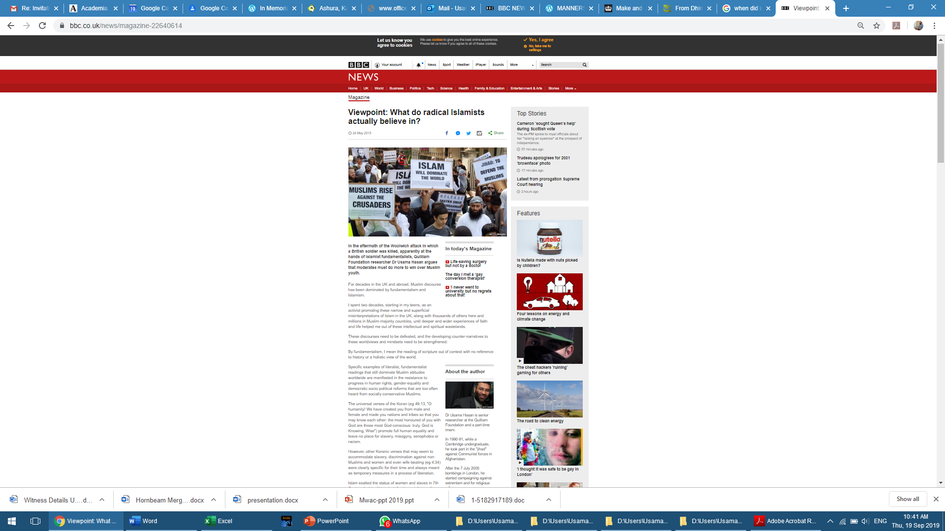

Slide 23
What Do Extremist Islamists Believe?
All Muslims are One Ummah (Nation), separate to non-Muslims
The Ummah must live under a Khilafa (Caliphate or Islamic State: dar al-islam, Land of Islam). Everywhere outside the Khilafah is dar al-harb (Land of War) or dar al-kufr (Land of Unbelief)
The Khilafah must enforce Sharia (Islamic Law) on everyone as the law of the land (state law)
Military Jihad to defend & expand the Khilafah, targeting all non-Muslims & their government institutions (dar al-harb: Land of War)

Slide 24
How the 4 assumptions of extremist ideology distort mainstream Islam
Four key Qur’anic notions,
distorted & used out of context:
Ummah (Muslims vs. non-Muslims) الأمة
Khilafah (Caliphate or Islamic State) الخلافة
Shariah (enforced on everyone as state law) الشريعة
Jihad (terrorism: targeting non-Muslims & govt) الجهاد

Slide 25
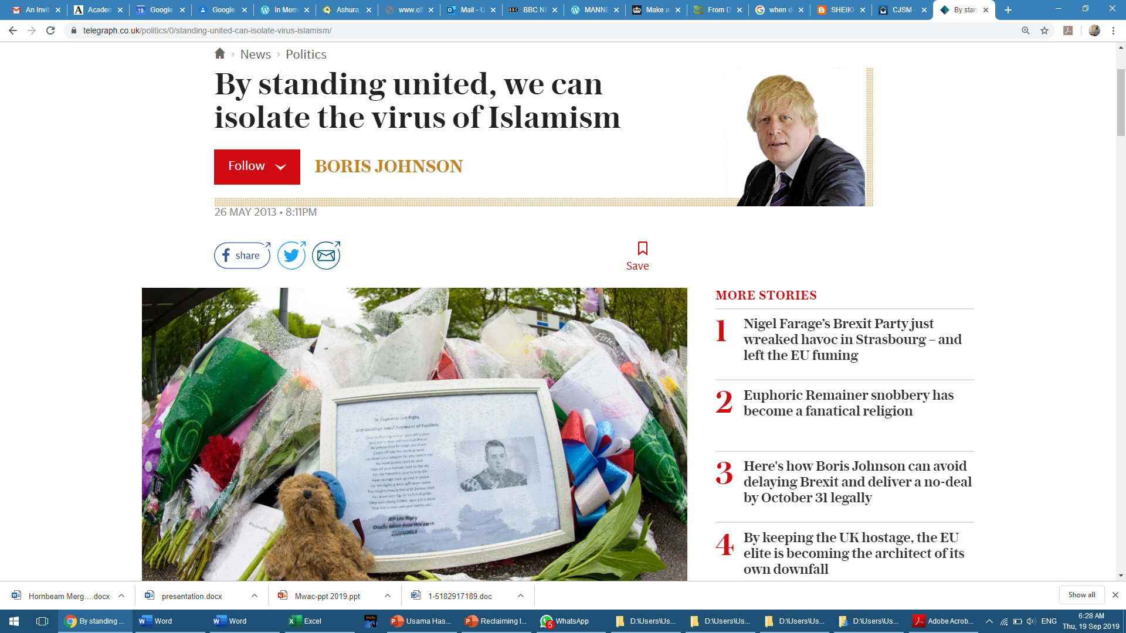
“The Islamists want universal sharia law, and other mumbo jumbo.”
Two days after my BBC article on Ummah, Khilafah, Shariah & Jihad

Slide 26
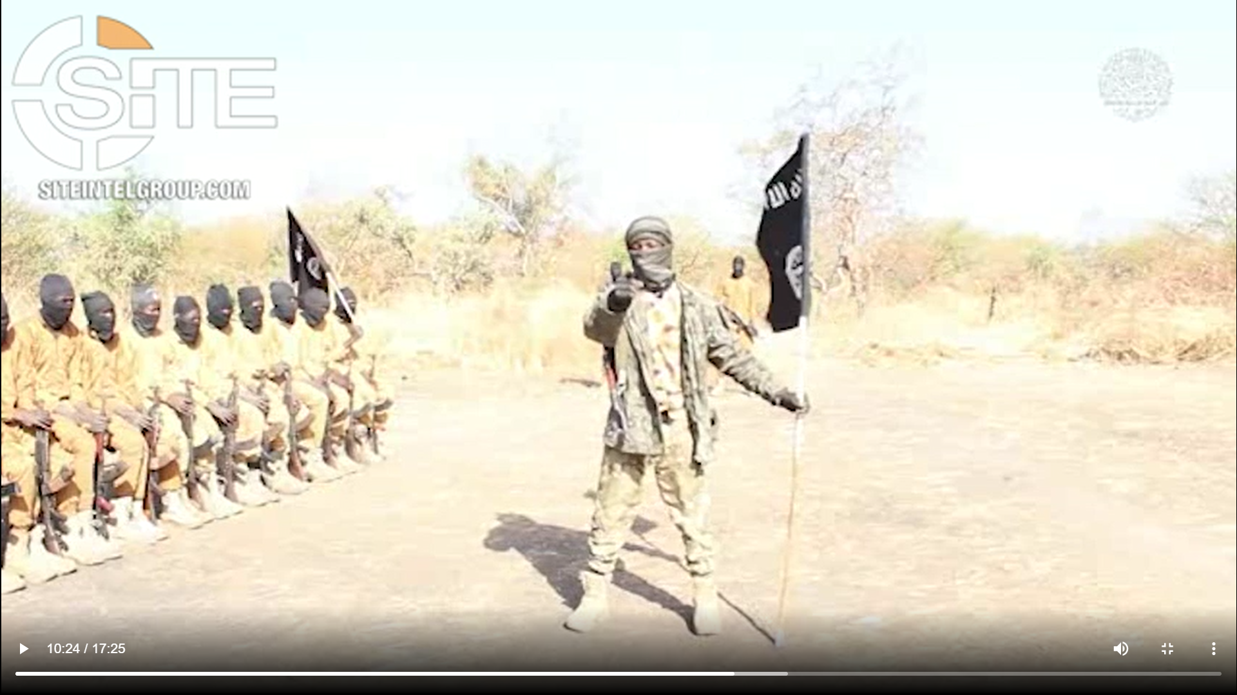
Example: terrorist video from January 2021
Our message to kuffar [non-believers]:
This is our flag. We are ready to die under the shade of this flag. You are flying the flag of kufr [blasphemy], and we are preparing against you, so as to fight for the cause of Allah [God].
You are fighting to defend constitutions, and we are fighting to defend the Holy Qur'an and the Sunnah [Way] of the Prophet Muhammad (Allah's peace and blessings be upon him). When we die in this fighting, we go to Paradise, Allah willing. When you die in this fighting, you go to bonfire.

Slide 27
“The Muslim World”

Slide 28
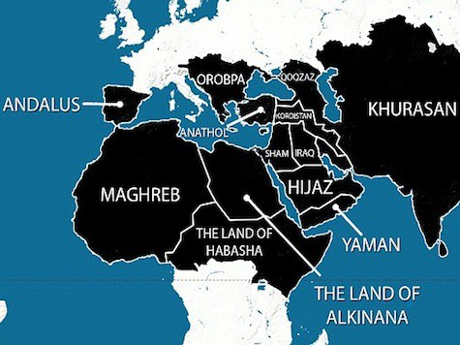
Al-Qaeda & Islamic State – Reviving a Medieval Caliphate

Slide 29

Reclaiming Islam for Muslims: 1- Ummah
Muslims are part of the worldwide ummah.
They are also part of their local ummah,
  e.g. US Muslims are part of the US ummah, alongside Americans of other religions.
The United Nations is United Ummahs
(Al-Umam Al-Muttahida) الأمم المتحدة
  AL-WALA’ WAL-BARA’ (loyalty & disavowal):
  Loyalty to Truth & Goodness
  Disavowal of Falsehood & Evil

Slide 30
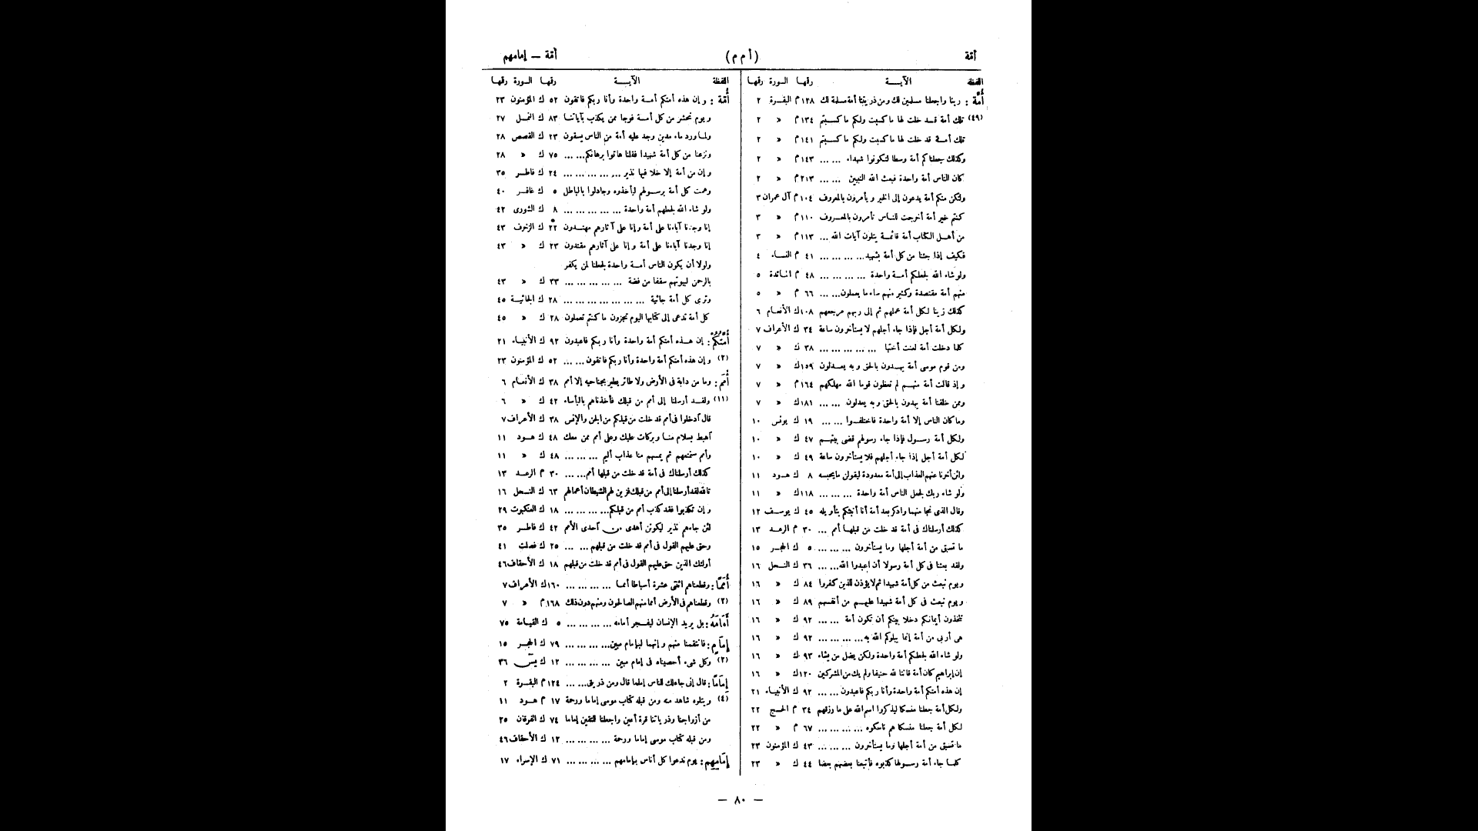
Reclaiming Islam for Muslims: 1- Ummah
50 occurrences + 15 derivatives of ummah in the Qur’an

Slide 31
Reclaiming Islam for Muslims: 1- Ummah
Qur’anic sense of the term ummah Number of occurrences in the Qur’an
A nation to whom a particular prophet was sent, including both believers and non-believers. 12
Humanity as one nation, ideally of goodness and devotion to God. 9
Humanity as a collection of nations. 5
Nations descended from Adam, Noah or Abraham. 5
Virtuous people amongst Israelites or “People of the Book” (primarily Jews & Christians) 4
Groups of people. 4
All virtuous people within humanity. 2
Muslims or followers of Prophet Muhammad (conditional upon being virtuous). 2
Virtuous people amongst the Muslims. 1
Groups of people entering the Fire (of Hell). 2
The Arabs of Prophet Muhammad’s era. 1
Non-Arabs of Prophet Muhammad’s era. 1
Israelites 2
The Prophets as One Nation. 2
Abraham as a Leader of Humanity. 1
Followers of a religion. 2
Nations of genies and humans. 2
Animal nations 1
A way of life 2
A period of time 2
TOTAL 62

Slide 32
Reclaiming Islam for Muslims: 2- Khilafah
There is no Sharia obligation for Muslims to establish a Khilafah.
Modern nation-states & democracies, are entirely acceptable in the Islamic Sharia.
Khilafah in Islam refers to doing our duty to our Lord (God), and to ruling with justice & mercy.
Dar Murakkab (composite/compound land) &
Dar al-Muwatanah (Land of Citizenship) are also found in Islamic Jurisprudence.
A democracy is Dar al-Dimuqratiya (Land of Democracy) according to contemporary Islamic scholars.

Slide 33
ISLAMISM’S VIEW OF THE WORLD
THE WHOLE WORLD
دار الإسلام DAR AL-ISLAM (LAND OF ISLAM) | دار الكفر DAR AL-KUFR (LAND OF INFIDELS)
 | دار الصلح DAR AL-SULH (LAND OF PEACE TREATY) | دار الحرب DAR AL-HARB (LAND OF WAR)

Slide 34
Ibn Khaldun (d. 810 AH / 1408 CE) on multiple caliphates or Islamic states
مقدمة ابن خلدون
Can Muslims have more than one ruler (imam/caliph)?
“Others hold the view that (the prohibition against two rulers) applies only to two rulers in one locality, or where they would be close to each other. Where this is great distances and the ruler is unable to control the farther region, it is permissible to set up another ruler there to take care of public interests.”
Ibn Khaldun, The Muqaddimah – An Introduction to History, Princeton, 2005, p. 158

Slide 35
Reclaiming Islam for Muslims: 2- Khilafah
Jurists agreeing that Muslims may have multiple rulers:
Isfarayini (d. 1027) الإسفرائيني
Maziri (1061-1141) المازري
Qurtubi (1214-1273) القرطبي
Ibn Kathir (1301-1373) ابن كثير
Ibn ‘Arafah (1316-1401) ابن عرفة
Ibn Khaldun (d. 1408) ابن خلدون
Ibn al-Azraq al-Gharnati al-Maliki (1427-1491) ابن الأزرق
Shawkani (1759-1834) الشوكاني
Qannuji (1832-1890) صديق حسن خان القنوجي
Numerous jurists : 20th-21st centuries CE

Slide 36
IBN TAYMIYYAH’S VIEW OF THE WORLD
(661-728 AH, 1263-1328 CE)
فتوى ماردين لابن تيمية
THE WHOLE WORLD
دار الإسلام DAR AL-ISLAM | دار مركّب DAR MURAKKAB (COMPOUND / COMPOSITE LAND) | دار الكفر DAR AL-KUFR
IBN TAYMIYYAH, THE MARDIN FATWA

Slide 37
MAINSTREAM ISLAM’S VIEW OF THE WORLD
THE WHOLE WORLD
دار المواطنة DAR AL-MUWATANAH (LANDS OF CITIZENSHIP: MODERN NATION-STATES)
DAR AL-MUWATANAH (NATION-STATE) | DAR AL-MUWATANAH (NATION-STATE) | DAR AL-MUWATANAH (NATION-STATE) | DAR AL-MUWATANAH (NATION-STATE)
دار الإسلام DAR AL-ISLAM (MUSLIM-MAJORITY) | دار مركّب DAR MURAKKAB (FEDERAL STATE e.g. Nigeria) | دار الصلح DAR AL-SULH (REST OF THE WORLD) | دار الحرب DAR AL-HARB (A COUNTRY AT WAR WITH KENYA)

Slide 38
Sheikh Abdullah bin Bayyah on modern nation-states, e.g. Nigeria
Ibn Bayyah: “The land of Islam (dar al-Islam) is every state having a Muslim majority or Muslim rulers, even if they do not implement some Sharia rulings. The land of non-Muslims (dar al-kufr) is every state having a non-Muslim majority and non-Muslim rulers. Compound or composite lands (dar murakkab) are exemplified by federal states comprising Muslims and others, where each province has the power to make laws, such as in Nigeria.”
Shaykh ‘Abdullah bin Shaykh Mahfuz bin Bayyah, Sina’at al-Fatwa [The Crafting of Jurisprudential Rulings], Dar al-Minhaj / Global Centre for Renewal and Guidance, 1428/2007, pp. 280-1

Slide 39
Reclaiming Islam for Muslims: 3- Sharia
The Sharia (Islamic Ethical Law) is all about wisdom and achieving people’s welfare in this life and the afterlife. It is all about justice, mercy, wisdom, and the common good. Thus, any ruling that replaces justice with injustice, mercy with its opposite, common good with mischief, or wisdom with nonsense, is a ruling that does not belong to the Sharia, even if it is claimed to be so according to some interpretation.
– Ibn al-Qayyim of Damascus, 14th century CE

Slide 40
Reclaiming Islam for Muslims: 3- Sharia
The focus of Sharia should be on ethics (maqasid)
  Sharia is both ethics (maqasid) & law
Is Sharia mainly voluntary or state-enforced ?
Where there is ikhtilaf (disagreement), may a ruler enforce one particular interpretation of Sharia in state law?
(e.g. cigarettes, TV, music, beard, niqab, etc.)
Imam Malik refused the Caliphs’ request to enforce Al-Muwatta’ on everyone

Slide 41
Reclaiming Islam for Muslims: 4- Jihad
Jihad is fundamentally a non-violent concept.
A holistic reading of Jihad in the Qur’an clarifies that its ultimate meaning is struggle at all levels for goodness against evil. This was expressed by dozens of theologians including Ibn Taymiyyah, whom Al-Shabaab like to quote to justify their extreme positions.
Modern Islamic warfare ethics, that are consistent with international agreements such as the Geneva Conventions, represent the only coherent understanding of military Jihad (qital) in the world today.

Slide 42
Reclaiming Islam from Islamist extremism:
An Exit Ramp
Qur’anic concept | Mainstream Muslim interpretation (also Post-Islamism) | Islamist extremist interpretation
الأمة Ummah (nation) | All of humanity (Bani Adam – Children of Adam & Eve); the Kenyan ummah (nation) | Muslim nation only; us-vs.-them
الخلافة Khilafah (authority/power) | Representative & just governance; modern nation-states including Kenya | Caliphate, Islamic State: a super-state ruled by a dictator-caliph
الشريعة Shariah (law & ethics) | Focus on Islamic ethics; law has always developed through ijtihad | Impose a narrow version as state law
الجهاد Jihad (struggle) | Spiritual / social struggle; sacred, just, ethical war; war can only be waged by legitimate authority (nation-states) | Non-state groups’ militant activity & terrorism

Slide 43
ISLAM & MODERN CITIZENSHIP
Kenya is a modern democratic nation-state, compatible with Islam. Kenyan citizens form the Kenyan Ummah (Nation).
All citizens are equal, irrespective of religion.
(Jew, Muslim, Christian, Hindu, Buddhist, Sikh, no faith, etc.)
Dealings with fellow citizens are based on human rights,
not on which religion each person follows.
The Kenyan Constitution is not opposed to the Qur’an, but based on the teachings of the Bible, Qur’an & other scriptures. These teachings include equality, freedom, truth, justice & mercy.
Similarly, the Kenyan flag belongs to every Kenyan!

Slide 44
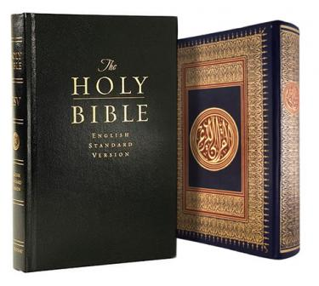

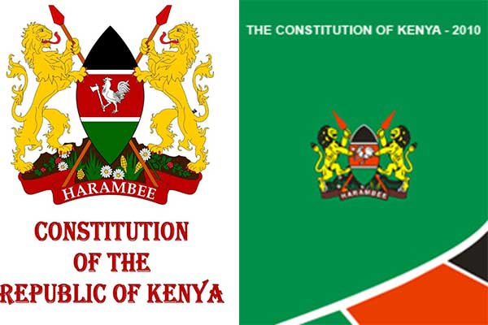

ISLAM & MODERN CITIZENSHIP
CONFLICT
OR
AGREEMENT ?

Slide 45
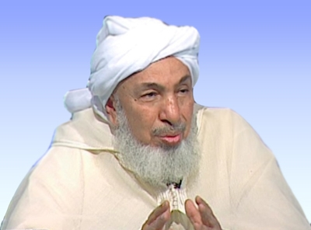
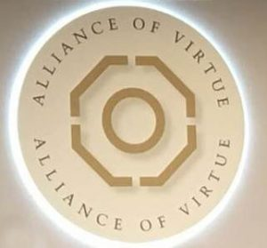

الشيخ عبد الله بن بيّه
Shaykh ‘Abdullah bin Bayyah: a leading Islamic theologian of our time
2018-19
The (New) Alliance of Virtue
حلف الفضول الجديد
2016-17: Marrakesh Declaration + Nation-States in Islam
الإسلام والدولة الوطنية

Slide 46
Shaykh Abdullah bin Bayyah: Islam & Modern Citizenship
Citizenship is a voluntary tie binding you to a homeland, ruled by a constitution, or what the German philosopher Habermas calls constitutional citizenship, i.e. the individual’s sense of belonging to a civic society founded on the sharing of basic values. Citizenship rises above group dynamics but does not cancel them: the aim is to blend and coexist with them successfully. The above is perhaps the most important development in the understanding of citizenship in the modern age. It is also perhaps the most important bridge by which the religious values of all human groupings may be respected and accepted. This accords with the understanding of Islam about human coexistence: a Muslim finds no harm in it, but rather may co-operate in it.
- Shaykh ‘Abdullah bin Bayyah, 2007

Slide 47
Bin Bayyah’s extraction of 11 principles from Medina Charter for Marrakesh Declaration 2016
In his keynote lecture at the historic Marrakesh Declaration conference in January 2016, Shaykh ‘Abdullah bin Bayyah argued that we need a modern equivalent of the Medina Charter, and listed 11 universal Qur’anic principles upon which this should be based, all of which are manifested in the Medina Charter:
kindness (Q. 2:195)
human dignity (Q. 17:70)
cooperation in goodness, mutual guarantee and reform (islah)
(Q. 5:2, 7:56, 28:77 & 2:220)
reconciliation (Q. 8:1)
human fraternity and mutual recognition (Q. 49:13) – according to Ibn Bayyah, “this is the basis of relationships, and not the mutual quest for domination, as in the Hegelian dialectic based on his master-slave theory.”
wisdom (Q. 2:269)

Slide 48
11 principles from Medina Charter for Marrakesh Declaration 2016 (cont’d)
welfare (Q. 7:170)
justice in dealing with people
(Q. 16:90)
mercy & compassion
(Q. 21:107, 7:156)
peace (Q. 2:208, 8:61)
loyalty to covenants and agreements
(Q. 5:1, 8:72)

Slide 49

Ottoman Sultan Mehmet II, 1808-1839
From among the subjects, where I distinguish who is Muslim is at a mosque, who is Christian, in a church and who is Jewish, in a synagogue. There is no difference between them on other days … O Greeks, Armenians and Jews! All of you, just like the Muslims, are God’s servants and my subjects. You have various religions, but you are all under the protection of the laws of the state and my royal will.

Slide 50

Muhammad Ali Jinnah
Founding father of Pakistan, 1947
You are free; you are free to go to your temples, you are free to go to your mosques or to any other place or worship in this State of Pakistan. You may belong to any religion or caste or creed that has nothing to do with the business of the State … We are starting with this fundamental principle that we are all citizens and equal citizens of one State … Hindus would cease to be Hindus and Muslims would cease to be Muslims, not in the religious sense, because that is the personal faith of each individual, but in the political sense as citizens of the State.

Slide 51
Recep Senturk, Emory University (2002)
The [Ottoman] Declaration of Regulations (Tanzimat Fermani, 1839) may be seen as the first Islamic human rights declaration in the modern sense … [and when the UN’s Universal Declaration of Human Rights was announced in 1948,] Turkish scholars of Islamic law, such as Kazim Kadri and Ali Fuat Basgil, produced works advocating that it was consistent with Islamic law and thus deserved the support of Muslims … The work of ancient prophets and philosophers can be seen as achievements towards a universal concept of [the] human.

Slide 52
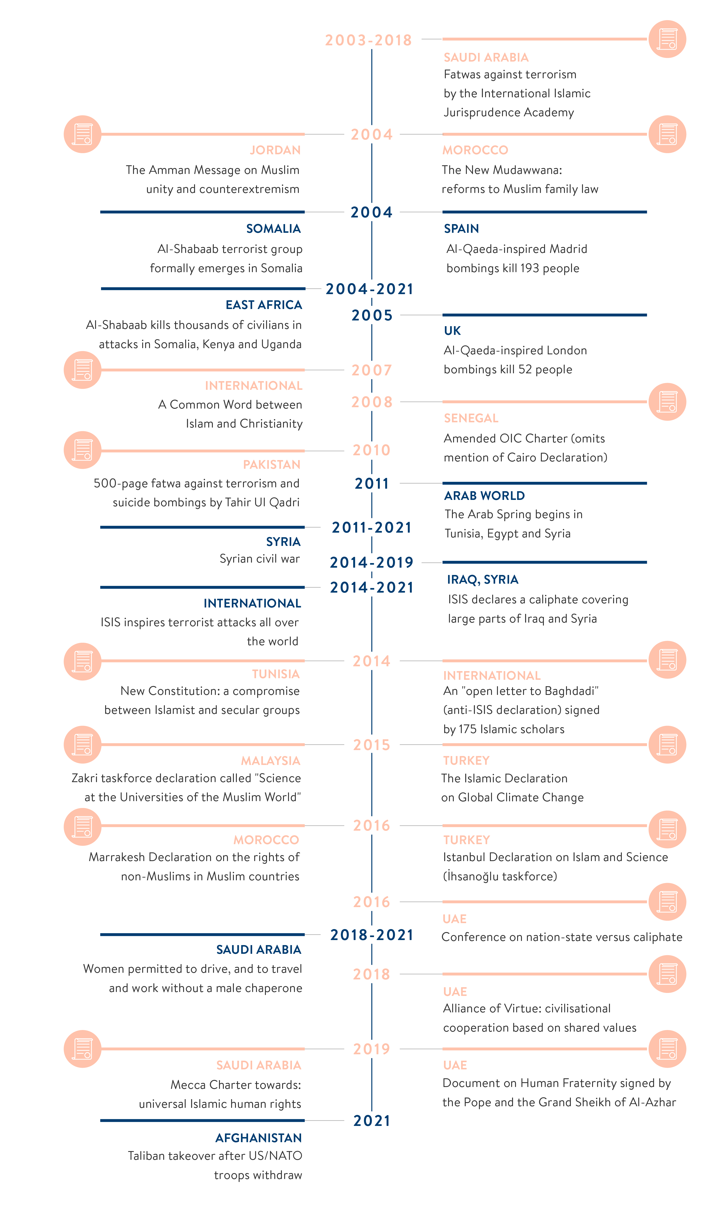

Slide 53
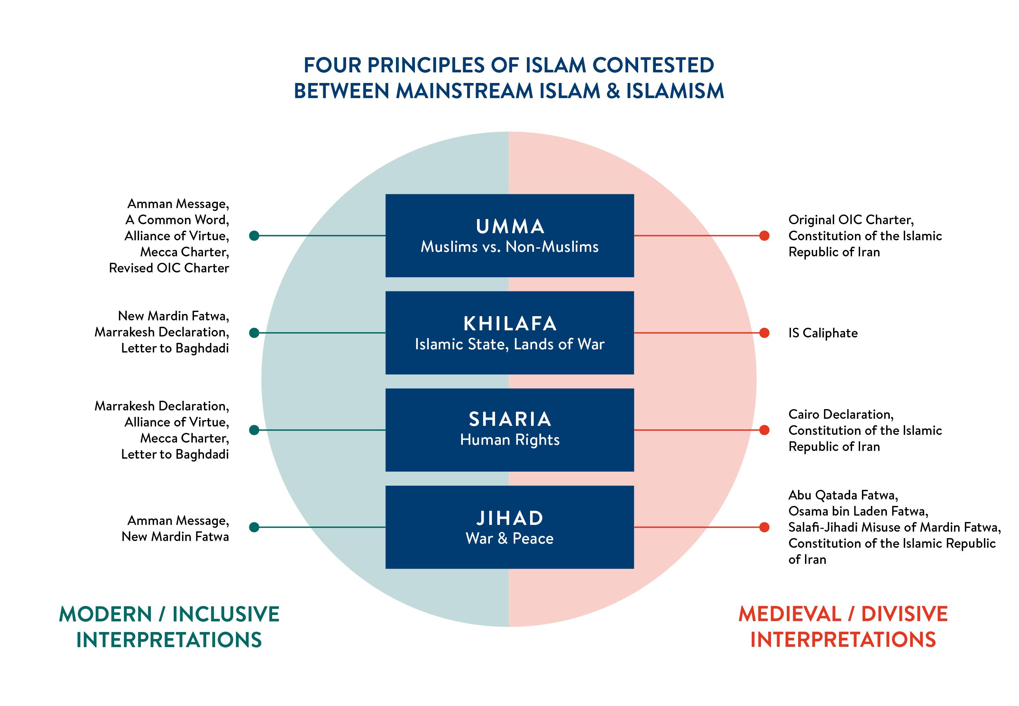

Slide 54
CASE STUDIES OF DERADICALISATION
Young Brit wants to bomb a bus
Young Brit wants to poison London’s water supply
UK teenager joins ISIS networks online & ends up in prison!

